Slide 1
Application of Composite materials in Aerospace Industry
Presented by:
Kanchha Lama (0991904)
Parth Patel (0989754)
Pramith Varikoti (0988868)

Slide 2
Contents
Introduction : What is composite?
Why composite in Aerospace industry?
Applications of composite in aerospace
Future involvement of composite
Conclusion

Slide 3
Introduction : What is composite?
Composite is material consisting of two or more materials, which have different physical and chemical properties, combined together in a proper content and fashion to produce a new material properties that are different from the properties of those individual materials.

Slide 4
Why composite in aerospace industry?
The main aim of the aerospace/aircraft industries is to reduce weight keeping the same or more strength than the regular metals have.
This criteria leads to use composite.

Slide 5
Advantages of composite material over metals
Light weight
High heat resistance
High strength to weight ratio
Low density
Corrosion resistance
High stiffness
Fatigue resistance

Slide 6
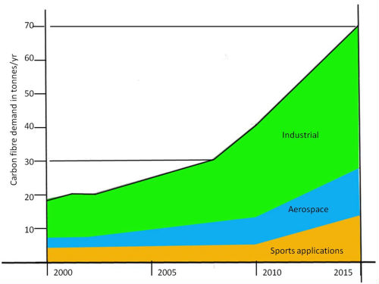
Graphical representation of use of composite materials over the years

Slide 7
Types of composites used
Fiber glass
CFRP
QFRP
GFRP
GLARE

Slide 8
Application of composite in Aerospace
Fuselage (Bulkhead)
Wing flaps
Rudder
Elevators
Radome
Spoilers
Floor beams and panels
Helicopter main and tail rotor blades
Space vehicles: Satellites, Missiles, Rockets etc.

Slide 9
Examples of use of composite in aircrafts : commercial and military
Commercial :
Boeing 777
Boeing 787 “Dreamliner”
Airbus A380
Military:
B-2 Bomber
LCA Tejas (HAL)

Slide 10
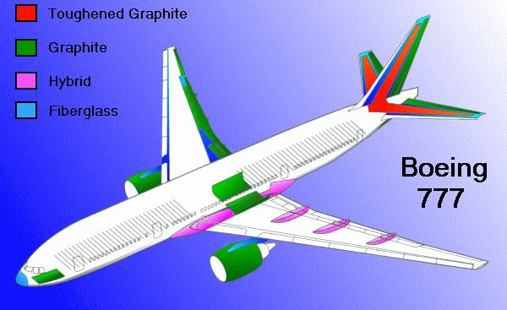
Boeing 777 composite Structure
Components that uses composite structure are:
Horizontal Stabilizer
Vertical Fin
Radom
Wing fairings
Passenger floor beams
Wing Box
Engine Cowlings
Engine fairings
Reduction in weight is over 5800 pounds.

Slide 11
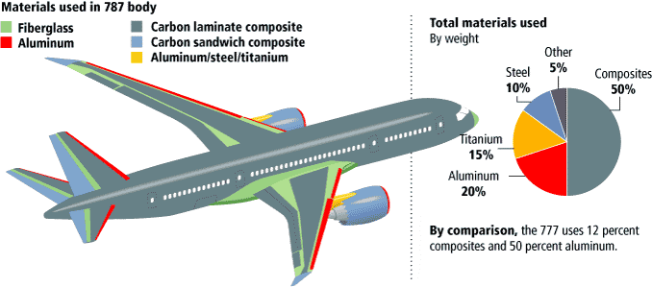
Boeing 787 “Dreamliner” Composite Structure
Components that uses composite structure are:
Almost full fuselage
Upper and lower wing skin
Radom
Wing flaps, elevators, ailerons
Vertical Fin and Horizontal Stabilizer
Use of composite is 80% by volume and 50% by weight.

Slide 12
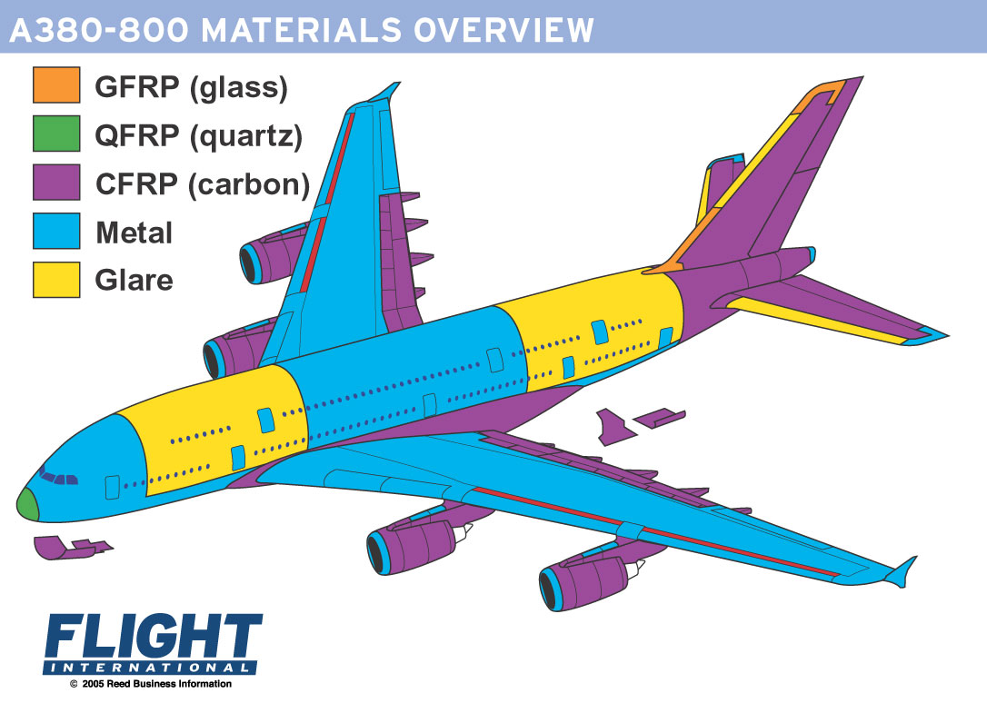
Airbus A380 Composite Structure
Components that uses composite structure are:
Horizontal Stabilizer
Vertical Fin
Radom
Wing Fairings
Wing Box
Belly Fairings
Engine Cowlings
Engine fairings
Wing box, made of CFRP, has reduced weight up to one and a half tones.

Slide 13
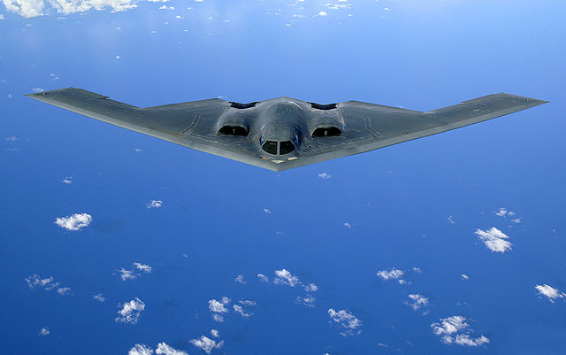
B-2 Bomber Composite Structure
B-2 Bomber is mostly made of carbon/epoxy materials.
The reduction in weight was about 40000 to 50000 pounds.
Design material was specially designed to absorb radar waves.

Slide 14
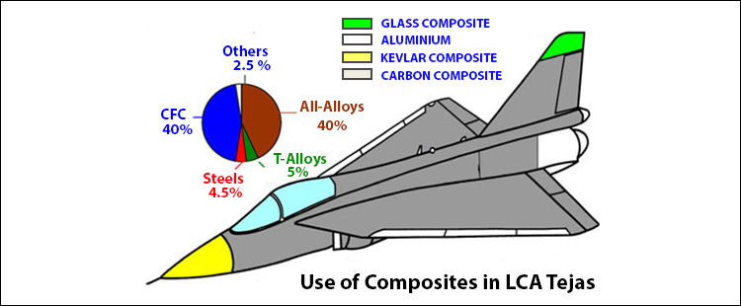
LCA Tejas (HAL)Composite Structure
LCA stands for Light Combat Aircraft which is basically use of composite materials in its structure.
Components which are made of composite material are:
Nose
Wing upper surface and leading edge
Exit Nozzle
Weight is reduced by 21%

Slide 15
Space vehicles Composite Structure
Used to manufacture Rocket and Missiles motor cases.
Materials for this are carbon, aramid and glass.
Composites like carbon-carbon are used to manufacture re-entry nose tips and heat shields.

Slide 16
Disadvantages of Composite Materials
Use of composite is more challenging to design.
NDT test for composite material is much more difficult as compared to metals.
Delamination of layers.
High cost
Damage tolerance.
Need specialized repair techniques.

Slide 17
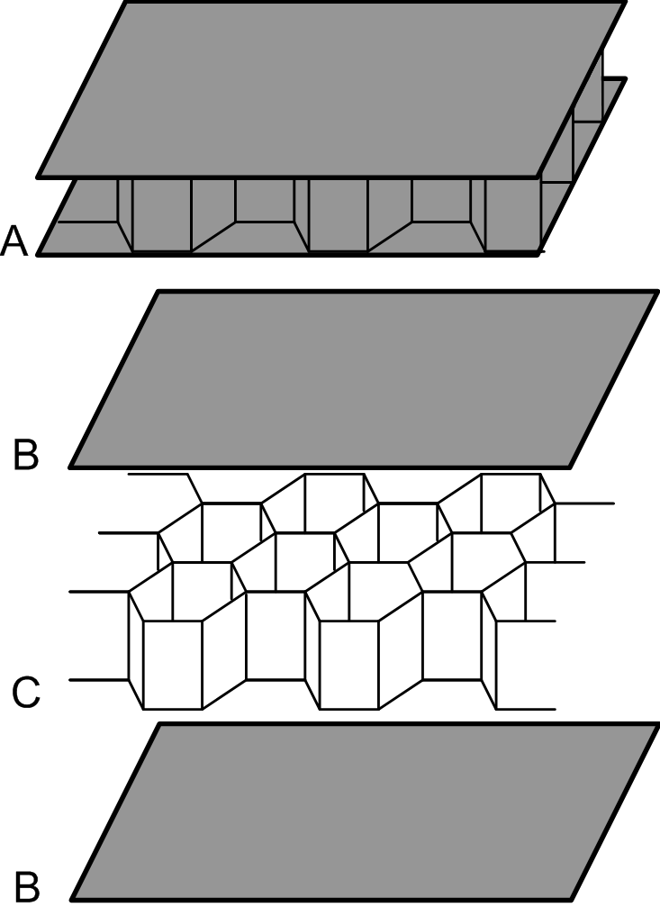
Future involvement of composite
Honeycomb Structure
Hybrid composite materials
Advanced Designs through Simulation
Investigations into damage tolerance of bonded repairs by test and simulation.
Honeycomb Structure

Slide 18
Conclusion
Since the invention of composite materials, aerospace industry has shown significant use of it in building different parts first to almost most of the structural parts and use of it is rapidly growing.
The main aspect we need to keep in mind that strength and stiffness are major considerations for aircrafts whereas stiffness and low coefficient of thermal expansion are major considerations for space applications.

Slide 19
References
Composite Materials. Retrieved from http://www.aviation-history.com/theory/composite.htm.
Creating a Titan. Retrieved from
http://www.flightglobal.com/news/articles/creating-a-titan-199071.
Daniel, I. M., Ishai, O.(2005). Engineering mechanics of composite materials. Oxford, New York, 2, 3-4.
Holly, R.H. (2013). The great metal tube in the sky. Retrieved from
https://arch5541.wordpress.com/2013/01/08/the-great-metal-tube-in-the-sky.
Honeycomb structure. Retrieved from http://en.wikipedia.org/wiki/Honeycomb_structure.
Hybrid material. Retrieved from http://en.wikipedia.org/wiki/Hybrid_material.
LCA Tejas Technology. Retrieved from
http://www.tejas.gov.in/technology/composite_materials.html.
National Aeronautics and Space Administration. Composites. Retrieved from
http://www.aeronautics.nasa.gov/pdf/composites_k-12.pdf.
Northrop Grumman B-2 Spirit. Retrieved from http://www.military-today.com/aircraft/b2_spirit.htm.

Slide 20
Thank You

